Slide 1

MINI PROJECT
ON
DESKTOP ASSISTANT
SUBMITTED TO:
MR. AYUSH SINGHAL
SUBMITTED BY:
SHIVANGI GARG(1902920100084)
ABHIJEET SINGH(1902920100003)
RIDDHI KAUSHIK(1902920100067)
AARADHYA SAINI(1902920100002)

Slide 2
CONTENTS
INTRODUCTION
HISTORY
BASIC CONCEPT SUSED
WORKING
AVAILABLE APPLICATION

Slide 3
INTRODUCTION
WHAT IS DESKTOP ASSISTANT ?
A desktop assistant or virtual assistant is a software agent that can perform tasks or services for an individual based on commands or questions.
It is an application program that understands natural language voice commands and completes tasks for the user.
Such tasks, historically performed by a personal assistant or secretary, include taking dictation, reading text or email messages aloud, looking up phone numbers, scheduling, placing phone calls and reminding the end user about appointments. Popular virtual assistants currently include Amazon Alexa, Apple's Siri, Google Assistant and Microsoft's Cortana -- the digital assistant built into Windows Phone 8.1 and Windows 10.

Slide 4
HISTORY
The 1990s digital speech recognition technology became a feature of the personal computer with IBM, Philips and Lernout & Hauspie fighting for customers. Much later the market launch of the first smartphone IBM Simon in 1994 laid the foundation for smart virtual assistants as we know them today.
In 1997 Dragon’s Naturally Speaking software could recognize and transcribe natural human speech without pauses between each word into a document at a rate of 100 words per minute. A version of Naturally Speaking is still available for download and it is still used today, for instance, by many doctors in the US and the UK to document their medical records.
In 2001 Colloquis publicly launched SmarterChild, on platforms like AIM and MSN Messenger. While entirely text-based SmarterChild was able to play games, check the weather, look up facts, and converse with users to an extent.^{[8]}
The first modern digital virtual assistant installed on a smartphone was Siri, which was introduced as a feature of the iPhone 4S on 4 October 2011.^{[9]} Apple Inc. developed Siri following the 2010 acquisition of Siri Inc., a spin-off of SRI International, which is a research institute financed by DARPA and the United States Department of Defense.^{[10]} Its aim was to aid in tasks such as sending a text message, making phone calls, checking the weather or setting up an alarm. Over time, it has developed to provide restaurant recommendations, search the internet, and provide driving directions.
In November 2014, Amazon announced Alexa alongside the Echo.
In April 2017 Amazon released a service for building conversational interfaces for any type of virtual assistant or interface.

Slide 5
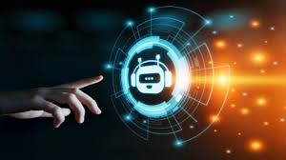

Slide 6
ADVANCED PYTHON
FUNCTIONS
DESKTOP DIRECTORIES
BASIC CONCEPTS
USED

Slide 7
WORKING
Virtual assistants like these can do everything from answer questions. They can respond to many voice commands, Anything you do on your phone, you can probably ask your virtual assistant to do for you.
Virtual assistants are passive listening devices that respond once they recognize a command or greeting (such as "Hey Siri"). Passive listening means the device always hears what's happening around it.

Slide 8
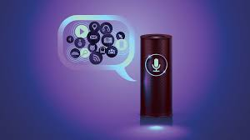

Slide 9
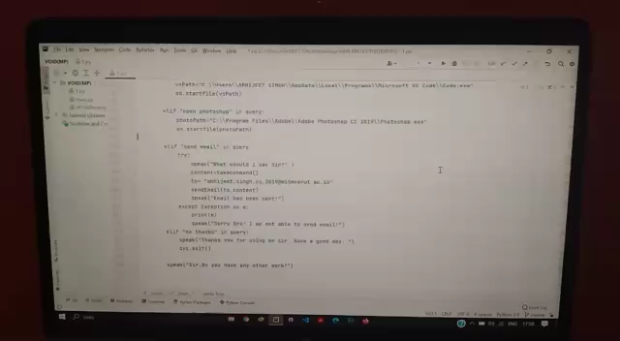
VOID
( the DESKTOp ASSISTANT )

Slide 10
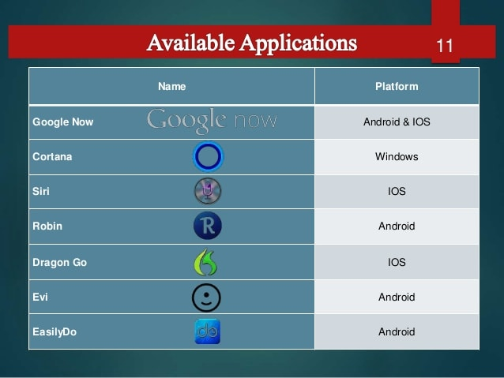
AVAILABLE APPLICATIONS

Slide 11
QUESTIONS ?

Slide 12
THANK YOU

